Slide 1
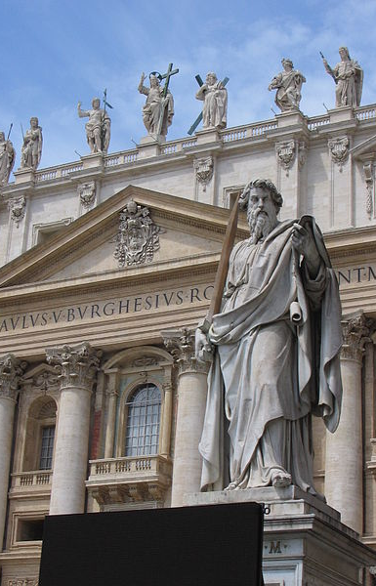
The Early Church
St Peter & St Paul

Slide 2
AD 33(ish)
You are one of Jesus’ disciples and you have had quite a year.
Your friend, teacher and leader – Jesus – was arrested, tried and crucified. He then resurrected from the dead, met with you and your friends on several occasions, before ascending into heaven before your very eyes.
Before he goes he says he’ll come back, but he won’t tell you when – “you also must be ready, for the Son of Man is coming at an hour you do not expect”.
How are you now feeling?
What should you do now?

Slide 3
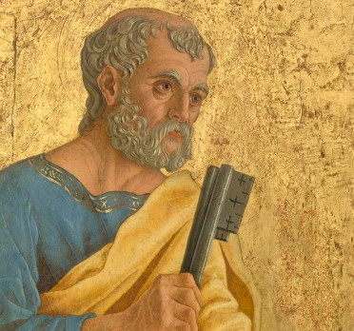
What happened after Jesus?
After Jesus’ crucifixion, James (the brother of Jesus) and Peter became the leaders of the Christian community in Jerusalem
They remained devout Jews (attending Temple, obeying dietary laws etc.)
They preached and converted many Jews, and apparently Gentiles, to the Jesus movement.
Where have we heard about Peter before?
Simon – renamed Peter as Petros (Cephas) meant ‘rock’
Fisherman and brother of Andrew
One of Jesus’ closest friends and disciples
Initially denied knowing Jesus and abandoned him immediately after his arrest

Slide 4
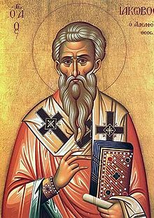
Identity crisis
The Jews referred to the group as ‘Nazarenes’, the Romans as ‘Christians’ – the early followers appear to have referred to their movement as ‘The Way’
As the movement grew, and more converted, the leaders faced a difficult question – what were the expectations of non-Jews (Gentiles) joining ‘The Way’?
Did they need to strictly abide by the Mosaic law?
Did they have to be circumcised?
Did they need to follow the dietary laws?
Many of the movement worried about admitting too many Gentiles: the pagan world was known for being depraved and impure
In fact, Jews were not even permitted to eat with pagans
Had Jesus been there, what do you think he would have said?

Slide 5
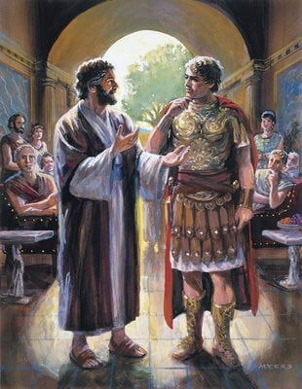
Peter and Cornelius
Let’s read Acts chapter 10 on biblegateway.com
Outline briefly what happens.
How does this resolve matters?
What lesson do you think that modern day Christians (and those of all faiths and none too) could learn from this story?

Slide 6
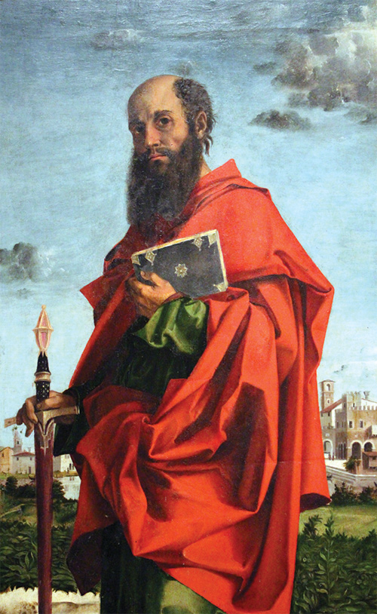

St Paul
Paul (Saul) was born in Tarsus, Turkey c. 4 BC – 4 AD
Jewish Roman citizen
Fervently persecuted Christians
c. 35/36 AD ‘Road to Damascus’ vision leads to his acceptance of Christ
Over 20-year period travelled west from Syria to Greece spreading Gospel

Slide 7
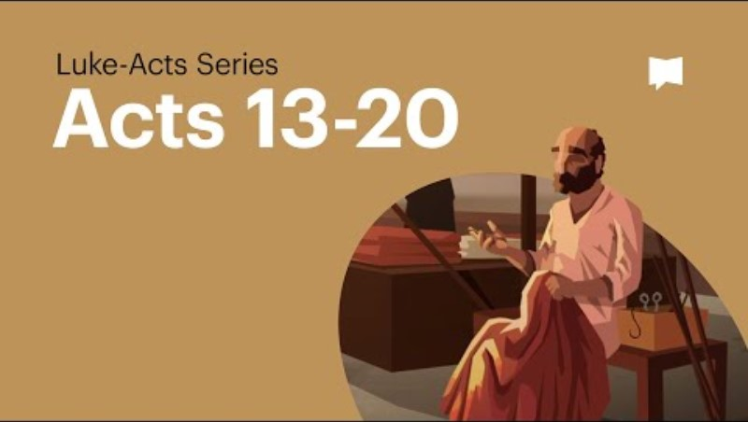
Write a bullet pointed summary of the story

Slide 8
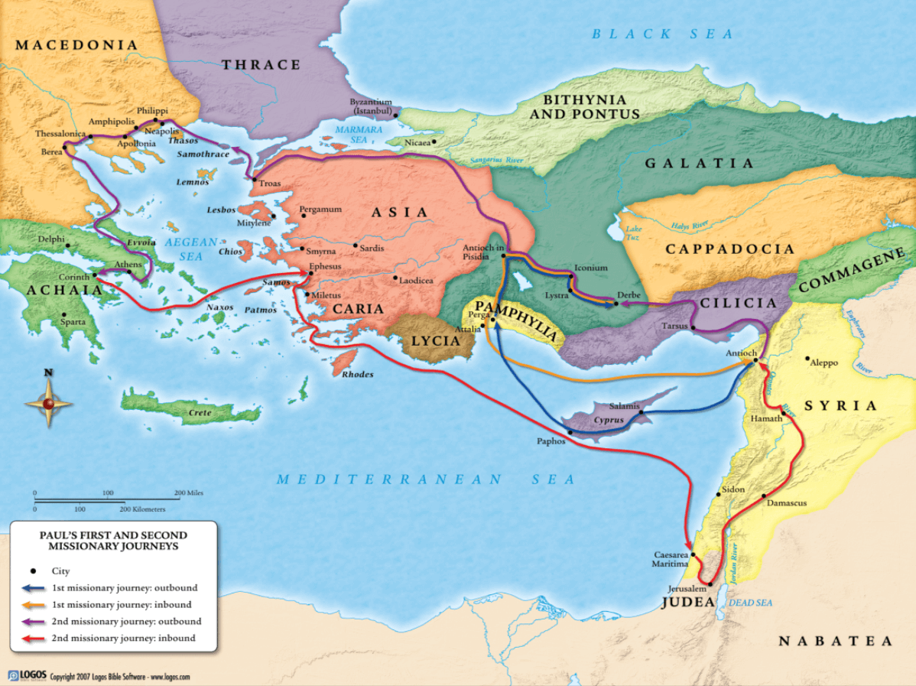
What were some of the issues that Paul faced as a missionary according to his letters?

Slide 9
¹⁶ Once when we were going to the place of prayer, we were met by a female slave who had a spirit by which she predicted the future. She earned a great deal of money for her owners by fortune-telling. ¹⁷ She followed Paul and the rest of us, shouting, “These men are servants of the Most High God, who are telling you the way to be saved.” ¹⁸ She kept this up for many days. Finally Paul became so annoyed that he turned around and said to the spirit, “In the name of Jesus Christ I command you to come out of her!” At that moment the spirit left her.
¹⁹ When her owners realized that their hope of making money was gone, they seized Paul and Silas and dragged them into the marketplace to face the authorities. ²⁰ They brought them before the magistrates and said, “These men are Jews, and are throwing our city into an uproar ²¹ by advocating customs unlawful for us Romans to accept or practice.”
²² The crowd joined in the attack against Paul and Silas, and the magistrates ordered them to be stripped and beaten with rods. ²³ After they had been severely flogged, they were thrown into prison, and the jailer was commanded to guard them carefully. ²⁴ When he received these orders, he put them in the inner cell and fastened their feet in the stocks.
Acts 16:16-24

Slide 10
2 You know, brothers and sisters, that our visit to you was not without results. ² We had previously suffered and been treated outrageously in Philippi, as you know, but with the help of our God we dared to tell you his gospel in the face of strong opposition
1 Thessalonians 2:1-2
⁹ For it seems to me that God has put us apostles on display at the end of the procession, like those condemned to die in the arena. We have been made a spectacle to the whole universe, to angels as well as to human beings. ¹⁰ We are fools for Christ, but you are so wise in Christ! We are weak, but you are strong! You are honored, we are dishonored! ¹¹ To this very hour we go hungry and thirsty, we are in rags, we are brutally treated, we are homeless. ¹² We work hard with our own hands. When we are cursed, we bless; when we are persecuted, we endure it; ¹³ when we are slandered, we answer kindly. We have become the scum of the earth, the garbage of the world—right up to this moment.
1 Corinthians 4:9-13
¹⁷ From now on, let no one make trouble for me; for I carry the marks of Jesus branded on my body.
Galatians 6:17

Slide 11
St Paul and the Christian faith
It’s hard to overestimate Paul’s influence on Christian doctrine
Many of the doctrines Christians take for granted as part of the faith were not from the gospels or the Old Testament, e.g. standard views of Original Sin
Paul gives Christians, for the next 2000 or so years, lots of theological/ethical puzzles to chew over
27 books of the New Testament, 13 of them penned by Paul
Writer of epistles to new Christian communities
Through these we get to know much more about Paul and early Christians

Slide 12
Matthew
Mark
Luke
John
Acts of the Apostles
Romans
1 Corinthians
2 Corinthians
Galatians
Ephesians
Philippians
Colossians
1 Thessalonians
2 Thessalonians
1 Timothy
2 Timothy
Titus
Philemon
Hebrews
James
1 Peter
2 Peter
1 John
2 John
3 John
Jude
Revelation

Slide 13
Matthew
Mark
Luke
John
Acts of the Apostles
Romans
1 Corinthians
2 Corinthians
Galatians
Ephesians
Philippians
Colossians
1 Thessalonians
2 Thessalonians
1 Timothy
2 Timothy
Titus
Philemon
Hebrews
James
1 Peter
2 Peter
1 John
2 John
3 John
Jude
Revelation

Slide 14
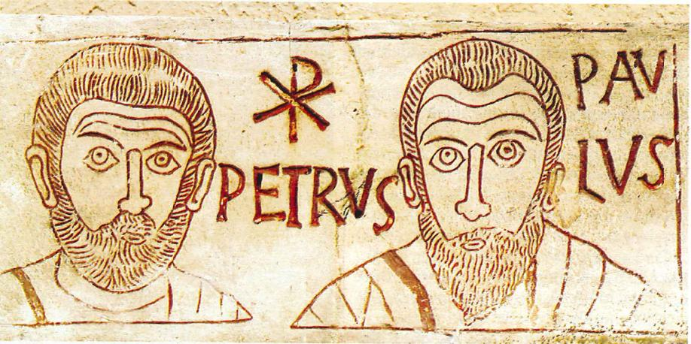
In your view, whose contribution to Christianity was more significant – Peter or Paul? Explain your answer, supporting your points with specific examples.
What might someone who disagreed with you argue?

